Slide 1


Harnessing the Potential of IT Professionals for National Development
Prof Liz Bacon
BCS President
liz.bacon@bcs.org
@BCSPres
Deputy Pro Vice-Chancellor
University of Greenwich, London
e.bacon@gre.ac.uk
Notes:
1

Slide 2


Overview
IT Professional of the future needs to know:
  Impact / Potential of IT
  Trends
IT professional workforce:
  Skills shortages
  e-Leadership
  BCS
  Education
  Women in Computing

Slide 3




Acknowledgements
IDC
Empirica
Cepis
RightScale 2014 State of the Cloud Report
Gartner
Innovation Value Institute
European Commission
Economist Intelligence Unit
Google EMEA
Center for Strategic and International Studies
L. Munasinghe, D.P.W. Jayawardena University of Kelaniya, Sri Lanka
ACM
Cisco
McKinsey Global Institute

Slide 4

Impact of technology
Transforming:
Every day life
Government
Services
Economy - increasing productivity and competitiveness in trade and industry, marketing (personalisation)
Home & leisure
Agriculture
How we access and communicate information
Education - how we understand and learn about the world
Inclusion is an issue

Slide 5
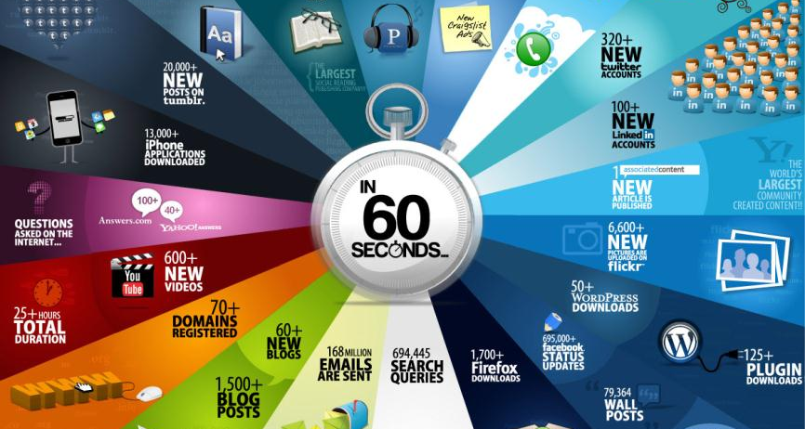
Every 60 seconds on the internet:
(June 2011)
        In 2017:
        It would take an individual over 5 million years to watch the amount of video that will cross global IP networks each month.
        Every second, nearly a million minutes of video content will cross the network.
        Cisco Systems 2013
        http://www.cisco.com/c/en/us/solutions/collateral/service-provider/ip-ngn-ip-next-generation-network/white_paper_c11-481360.html
Kelly Hodgkins http://gizmodo.com/5813875/what-happens-in-60-seconds-on-the-internet

Slide 6
Internet Bandwidth
Bandwidth / Wifi / internet (92.1 terabits per second in May 2012)
International capacity not within country, Africa < 1TB
Expect 606.6 terabits per second in 2018
1,103.3 terabits per second in 2020
http://arstechnica.com/business/2012/05/bandwidth-explosion-as-internet-use-soars-can-bottlenecks-be-averted/
Notes:
Infographic showing rise of wi-fi networks and bandwidth over time ?
http://arstechnica.com/business/2012/05/bandwidth-explosion-as-internet-use-soars-can-bottlenecks-be-averted/
“The terabits per second shown above represent the total international capacity in IP backbones, private networks, research and educational networks, etc. These numbers show the available capacity for data to travel from one country to another, both through undersea cables connecting nations separated by water and by the terrestrial links between countries with land borders. So links from New York to Washington, DC are not counted, while links from New York to Europe, and from one European country to another, are reflected in the data.” Africa has less than a terabit! 700 GB
1 terabit = 10¹²bits = 1000000000000bits = 1000 gigabits
“As the head of a bandwidth assessment group at the IEEE (Institute of Electrical and Electronics Engineers) and past chairman of the IEEE's task force on 40 Gigabit and 100 Gigabit per second Ethernet, John D'Ambrosia is among the people who will help guide the world toward 400 Gigabit and even Terabit per second speeds. But will our capacity to deliver bandwidth keep up with the human race's ability to consume it?”
May 2012 more than 1/3rd of the world’s population is online.
“It would take an individual over 5 million years to watch the amount of video that will cross global IP networks each month in 2017. Every second, nearly a million minutes of video content will cross the network in 2017.”
http://www.cisco.com/c/en/us/solutions/collateral/service-provider/ip-ngn-ip-next-generation-network/white_paper_c11-481360.html
Stats on ubiquity of mobile devices

Slide 7
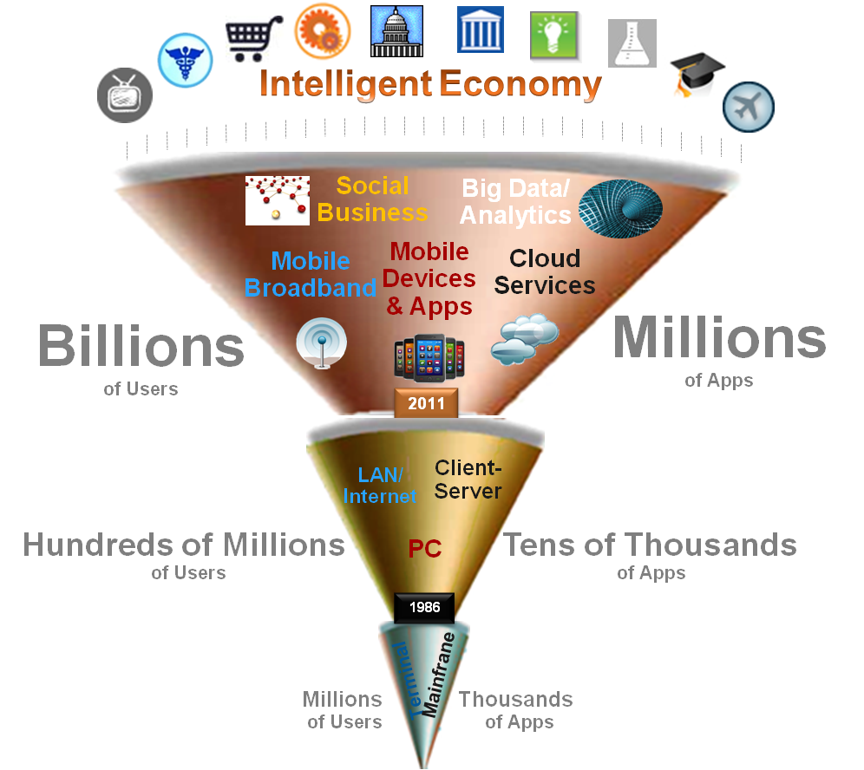

By 2020, the IT industry will be dominated by today’s new disruptive technologies…
  Disruptive Technologies
  Cloud computing
  Mobile devices and apps
  Social technologies
  Big Data analytics
  Internet of Things
  Today = about 22% of global IT spending
  2020 = 40% of the market and 98% of growth
  2020, ICT industry will generate nearly €4 trillion in spending worldwide

Slide 8
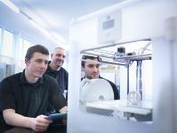

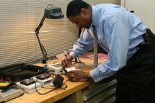
Additional Trends
In addition to:
Cloud, Mobile, Big data analytics, Internet of things, Social tools and technologies
Add:
3D/4D printing
Challenges:
Cyber Security Shadow IT

Slide 9
Trends - Mobile
March 2013 6/7 people on the planet had access to a mobile phone – only 4.5/7 had access to a toilet!
Facebook had 100 million mobile phone accesses per day (2010)
2013: 17.4% of web traffic came through mobile (>6% on 2012)
By 2016 the number of people accessing the Internet through PCs will shrink by 15 million as the number of mobile users increases by 91 million

Slide 10
Trends - Mobile
In 2013, both the Apple App store and Google Play exceeded the 50 billion downloads threshold.
In both cases, half of the total downloads occurred in the preceding 12 months.
IDC estimates that smart mobile devices will generate 57% of the IT industry’s overall growth worldwide (Gens, 2013)
98% of mobile apps not used one year after release

Slide 11
Trends - Cloud
Clouds are a large pool of easily usable and accessible virtualized resources (such as hardware, development platforms and/or services). These resources can be dynamically re- configured to adjust to a variable load (scale), allowing also for an optimum resource utilization. This pool of resources is typically exploited by a pay-per-use model in which guarantees are offered by the Infrastructure Provider by means of customized SLAs (Vaquero et al, 2009).
Characteristics that distinguish from traditional resource provision models
      On-demand
      Internet based
      Resource-pooling
      Infinite capacity
      Demand-driven billing
Public
Private
Hybrid

Slide 12
Trends - Cloud
Traditional
IT Spending
Cloud Spending
Cloud is key for digital innovation
Traditional SW and HW spending transforming into SaaS, IaaS
Cloud is an enabler of mobility and Big Data, an enhancer of IoT

Slide 13
Cloud Workforce Skills
An article in Forbes magazine cited eight essential skills for cloud computing:
  Business and financial skills
  Technical skills
  Security and compliance
  Project management skills
  Contract and vendor negotiation
  Data integration and analysis skills
  Enterprise architecture and business needs analysis
  Mobile app development and management skills

Slide 14
Trends – Big Data Analytics, Data Visualisation
IBM - ‘every day, we create 2.5 quintillion bytes of data” i.e. 90% of world’s data created in the last two years – growing by 50% per year! (ACM)
In 2010 Eric Schmidt said “Every 2 Days We create as much information as we did up to 2003”.
Gartner predicts that 4.4 million IT jobs globally will be created to support big data, with 1.9 million of those jobs in the US (Lundquist, 2012).

Slide 15
Trends – Big Data Analytics, Data Visualisation
Data scientists are the experts who know how to devise mechanisms for extracting answers to key business questions from the quagmire of unstructured data that exists in organisations today
A role that typically demands a scientific background with computational and analytical skills.
Growth exploding in bioinformatics careers due to wealth of data being generated – need people to make sense of it!

Slide 16
Big Data – how it is changing society
Analysis of anonymised mobile phone data - track commuter journeys from home to work, re-routed buses reduced commuter time by 10% in one city.
Understanding patterns of movement through analysis of cell tower hopping can tell you how disease will spread
  Typical patterns of behaviour e.g. daily routine, triggering health alerts if these change.
Analysis of taxi journeys in San Francisco (Sandy Pentland MIT) classify people into urban tribes and their typical behaviour – what they wear, how social they are, music they like, how much they exercise, typical health problems e.g. diabetes, patterns of health (reduce healthcare costs if problems caught early)
Personalised adverts on web, TV
Cars monitor driving habits and report to insurance

Slide 17
Big Brother?
Many companies now offering benefits for free in exchange for your data because it has value
Data can be very personal or anonymised
Use for good or bad - who has access to it, how it’s used, if the owner knows, what control the owner of that data has etc.
The big issues are about individual knowledge and control of their own data, many people don’t care – Facebook?
Legislation can establish ownership but difficult to find your data except in more regulated industries like Banks
Elsewhere - resulting in new industries springing up to help people find and manage their data.

Slide 18
Trends – Internet of Things
Objects, people, animals etc. have unique identifiers and can communicate over a network automatically.
Cisco (2013) estimates:
  The potential economic impact is as much as $14.4 trillion for private sector businesses worldwide, with:
  “the potential to increase global corporate profits by approximately 21% in aggregate over the next 10 years”
  This estimate does not include the potential value to citizens, communities and countries.
IoT solutions are mostly deployed to address issues around the supply chain, product/asset tracking, retail, healthcare, logistics.

Slide 19
Trends – Internet of Things
Potential to create smart environments (cities, energy, transport, smart buildings, health, manufacturing, retail, homes etc).
Car has component failure – reports to garage, you drive there, component and mechanic waiting as alerted in advance
Wearable technology and augmented reality will change how we interact with brands. I’m already googling whether that statement is true with my glasses…
The Internet of Things might make judgements on what I have for dinner. And order the food and cook it.
As long as my microwave hasn’t defriended me on Facebook

Slide 20
Trends – Future impact of IOT
(Economist Intelligence Unit)

Slide 21
Trends – Social Tools and Technologies
1.5 billion people used social networks regularly in 2012
Study by Google EMEA found:
  A third of professionals use external social media for work related purposes daily
  25% are using in-house social tools daily, and over 50% use them at least once per week
  Senior managers use was 71%, staff in more junior roles was 49%
Companies could raise the productivity of interaction workers by 20 to 25 percent” (Bughin et al, 2012).
Estimate in only four industries, social platforms could unlock $900bn to $1.3 trillion in value annually (McKinsey)

Slide 22
3D / 4D Printing and Market Disruption

Slide 23
3D / 4D Printing and Market Disruption
BAE Systems have already printed a part for an aeroplane
Chinese materials firm has reportedly produced 10 3D-printed buildings (excluding the roof) in 24 hours, using a custom-built machine that outputs layers of construction waste mixed with cement (BBC April 2014).
4D printing – “over time static objects will transform and adapt”, programmable material build themselves - uses water to provide flexibility – print clothes instead of washing them, print human organs from stem cells.
Finished object will self-assemble or transform into a pre-determined form – already achieved!
Consumers will expect not to have to choose between mass produced and bespoke items - will expect personalisation on an industrial scale.

Slide 24
An Indicative Roadmap of Technologies
  Today (2014)...
  Cloud Computing, Mobile Apps
  Some social business
  Tomorrow (2-3 years) ...
  Big Data, Social Technologies close to mainstream
  Increasing diffusion of IoT
  In 5-6 years (∼2020)
  Convergence of main trends
  IoT & Cloud & Big Data

Slide 25
Challenges – Shadow IT
Shadow IT – Organisational IT systems created and without approval or support from the centralised IT function.
Pros
Perceived as being more responsive to business needs
Fulfils a need
Cons
IT fiefdoms and data silos that do not collaborate with other areas
Often not backed up
Duplicate data - error prone
Not linked to central data
.
Analyst reports “more than 90% of business units are spending their own funds, outside the formal IT budget on technology” (Schectman, 2013).
Gartner estimates – in 2000, 20% of technology spend was taking place outside of IT.
Predicts in 2020 will be 90%

Slide 26
Challenges – Cyber Security
A 2013 report into the economic impact of cybercrime and cyber espionage (Center for Strategic and International Studies, 2013) identified six components to losses from cyber-crime and cyber espionage:
  Loss of intellectual property and business confidential information
  Cyber-crime (including knowing it has happened)
  Loss of sensitive business information, including negotiation strategies
  Opportunity costs, including service and employment disruptions, reduced trust for online activities
  Additional cost of securing networks, insurance and recovery from cyber attacks
  Reputation damage to the hacked company

Slide 27
Challenges – Cyber Security
Report estimates that the cost of cyber espionage and crime could be as high as 0.5% to 1% of national income.
Globally the losses could be $100 billion to $500 billion.
International IBM survey of IT decision-makers (IBM Center for Applied Insights, 2012), security concerns ranked “as the most significant barrier to adoption across mobile, cloud computing and social business”.
“Securing and controlling access to data was placed as the number 2 barrier to adoption for business analytics”.
~80% of breaches are through human mistakes etc, not cyber.

Slide 28
Workforce – skills shortage
Africa - change employment dynamics in the near future.
“By 2020, the African economy is projected to add 220 million people to the workforce, creating a continent wide labour force of more than 500 million” (Brent Wilton - International Organisation of Employers, Eroke, 2013).
Majority of new employment likely to be in retail, hospitality, manufacturing and agriculture, the ability of Africa to engage in the ICT industry is often understated, and is likely to change. (European Commission e-skills report 2014)
Over 197 million people worldwide are without a job in 2012.
“Labour market institutions and policies have not kept up to date with the changes in business practices and technology that are defining what kind of jobs will be created and where they will be created” (McKinsey).
Survey of 70 European CIOs/senior IT managers - Likely Offshored: coding, software testing and ICT support.

Slide 29
Demand: ICT Workforce Development in Europe 2012 – 2015 - 2020
Source: Gareis, K., Hüsing, T., Bludova, I., Schulz, C., Birov, S., Korte, W.B.: e-Skills: Monitoring and Benchmarking Policies and Partnerships in Europe (Final Report for the European Commission, January 2014)

Slide 30
The IT Professional of the Future
Profile and Behaviours
A communicator, able to demonstrate the business benefit of technology in clear terms and defined outcomes.
A next practice horizon scanner, interested in the transition between that which is giving early adopter advantage and the best practice portfolio.
Able to demonstrate a portfolio of skills depending on the context.
A creative and disruptive influence within the business, creates connections and makes others better at what they do.
Comfortable serving in multi-disciplined teams without clear and concise definitions.
A business partner and enterprise contributor.

Slide 31
e-Leadership
As organizations rely more on ICT, they are demanding e-leaders who are both business and ICT savvy.
An e-leader motivates and guides multi-disciplinary professionals to use ICT to creatively exploit digital opportunities for business innovation and stakeholder value
Ability to exploit opportunities provided by ICT and new ways of conducting business
Skills:
  Leadership
  Business
  IT
  Entrepreneur
  Imagination

Slide 32
E-leadership skills consist of a T-shaped portfolio of skills, representing 3 dimensions of expertise.
3: Developing Organizations
(Horizontal/Transversal Expertise)
Developing a compelling vision; Design and Experimentation; Making sense of a situation
Building and aligning relationships across boundaries; Innovating and Managing change
1: Expertise in Systems of ICT
Enterprise Architecture
IT Governance
Application Development
Security
Data Analytics
2: Expertise in Business
Function & Operational expertise
Product expertise
Customer & Sector expertise
Source: INSEAD, empirica and IDC. (2013). “e-Leadership: Skills for competitiveness and innovation.” available at http://eskills-vision.eu/home/ and http://ec.europa.eu/enterprise/sectors/ict/files/eskills/insead_eleadership_en.pdf
32
Notes:
To accomplish some activities it is sufficient to have a:
strategic understanding (knowing what is possible)
For others, it is important to have a
practical understanding (knowing how to do the possible)
TRANSITION (return to previous slide)
To estimate demand for e-leadership, we estimated how many e-leaders a firm would need to accomplish these eight activities.

Slide 33
BCS Purpose
We set and maintain the standards in IT
Enabling digital literacy for all members of society e.g. ECDL
Accredit university degrees – aim to equip students with the skills to succeed in the workplace
Helping global enterprise align its IT resources with strategic business goals utilising SFIA
Increasing the capability of IT professionals
Directly supporting over 76,000 IT Professionals through membership

Slide 34
BCS - membership
Branches and Specialist Groups e.g. security, quality
Membership: student, associate, members, fellows etc. (not legal requirement)
Chartered Status: CITP, CEng, CSci
Income: membership fees, products and services, education and training etc.

Slide 35
An international reach
UK
Belgium
France
Finland
China
Spain
Japan
Hong Kong
United States
Singapore
Greece
India
Egypt
Middle East
Kenya
Pakistan
Mauritius
Australia

Slide 36
BCS and e-Leadership
  BCS led the development of one of the first skills frameworks, SFIA, recognising:
    The important of defining professional roles and responsibilities within the industry.
    Promoting professionalism in the IT industry as a means of driving capability for both individuals and organisations to develop e-Leaders.
    Providing education to help people achieve higher levels of skills framework - Chartered IT Professional (CITP)

Slide 37
Competence Frameworks
Skills Framework for the Information Age (SFIA) – SFIA Foundation (UK) – used in over 100 countries
European e-Competence Framework (e-CF) – CEN (European Standardisation Committee) ICT Skills Workshop
Common Career Skills Framework – IPA (Japan)
IT Competency Model – ETA/ODEP (US)
Occupational Skills Framework (OSPM) – ICTC (Canada);
National Curriculum and Competency Framework (under development) – e-Skills Institute (South Africa).

Slide 38
e-Leadership - Best Practice and Next Practice
Best Practice - doing today’s stuff best
Next Practice is doing tomorrows stuff first.
You must exploit IT and technology skills to disrupt your own market.
The challenge is to have the capability and insight to disrupt your organisation before someone does it for you.

